Slide 1

Cold Start Energy Forecast
Data Mining and Analysis (18ECSC301)
Course Project
on
TEAM MEMBERS:
Apoorva Hegde 01FE16BCS040
Ganesh Jadhav 01FE16BCS070
Girish Illanad 01FE16BCS071
Hemanth Kumar 01FE16BCS072

Slide 2
Problem Statement
To forecast energy consumption from varying amounts of cold start data, and little other building information.

Slide 3
Introduction to challenge
This is one of the challenges in the "Power Laws" series run by Schneider Electric.
Schneider Electric SE is a French multinational corporation that specializes in energy management, automation solutions, spanning hardware, software, and services.
Hosted by Driven data.
We must make accurate predictions for new buildings, which don't have a long consumption history (cold start).

Slide 4
DATASET
The dataset provided are in 4 formats.
Consumption train.
Cold start test.
Meta.
Submission format.

Slide 5
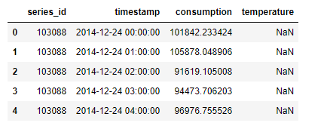
Data Snapshots(training data)
Number of rows:509376
Number of columns:5

Slide 6
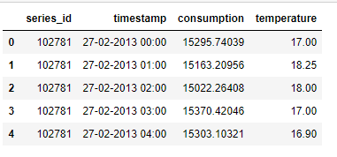
Data Snapshots(testing data)
Number of rows: 111984
Number of columns:5

Slide 7
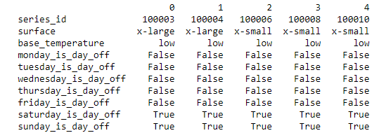
Data Snapshot(meta data)
Number of rows:1383
Number of columns:10

Slide 8
Understanding Data
Attributes of training and testing dataset:
'series_id', 'timestamp', 'consumption', 'temperature‘.
Attributes in meta data file:
'series_id', 'surface', 'base_temperature', 'monday_is_day_off', 'tuesday_is_day_off', 'wednesday_is_day_off', 'thursday_is_day_off', 'friday_is_day_off', 'saturday_is_day_off', 'sunday_is_day_off’.
Surface: ‘x-large’, ‘x-small’, ‘medium’, ‘large’, ‘xx-large’, ‘xx-small’.
Base temperature: ‘low’, ‘high’.

Slide 9
Understanding Data
Missing data
The total missing values in training = ~40%
The total missing values in testing= ~44%
Outlier check
Temperature : Min = -13.47C , Max = 44.35C
Consumption : Min = 0 , Max = 42MegaWatts
Unique data
Total unique series id’s in training data = 758
Total unique series id’s in training data = 625
Total unique series id’s in meta data = 1383

Slide 10
DATA PREPROCESSING
Data Integration
Concatenating training and testing data.
Merging with meta data(on series id).
No. of rows = 621360
No. of columns = 13(4+2+7)
Missing data = 44%(temperature only)

Slide 11
DATA PREPROCESSING
Data Transformation
Extracting units of time from timestamp(1->5)
timestamp = minute, hour, weekday…
Converting time variables to cyclic features(1->2).
Weekday = sine(Weekday)+cos(Weekday).
Converting days off to a single attribute(7->1).
True = 1
False = 0

Slide 12
DATA PREPROCESSING
Missing Values
Total missing data = ~44%(temperature)
Groupby on series id, month and year fill with mean.
Total missing data = ~34%(temperature)
Groupby on series id, month and year with mean.
Total missing data = ~33%(temperature)
Machine Learning (RandomForestReggresor)
No missing data!

Slide 13
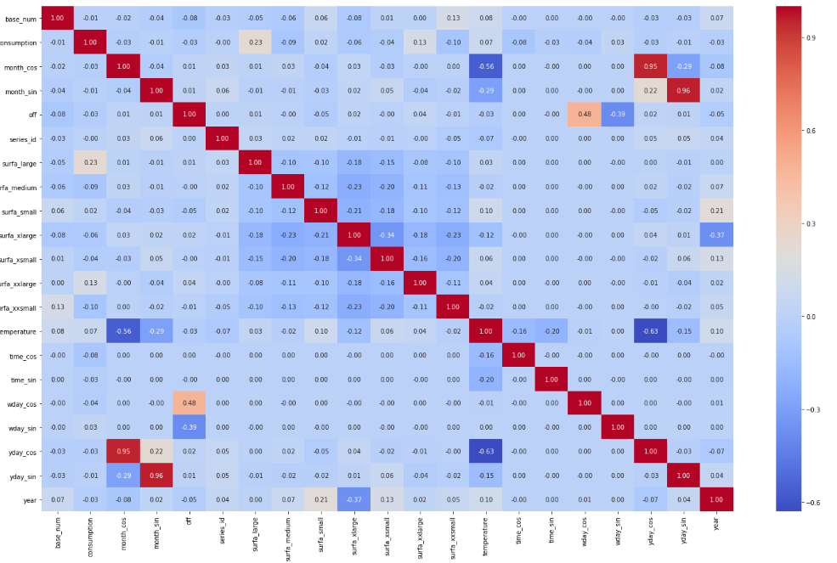
DATA PREPROCESSING
Feature Engineering

Slide 14
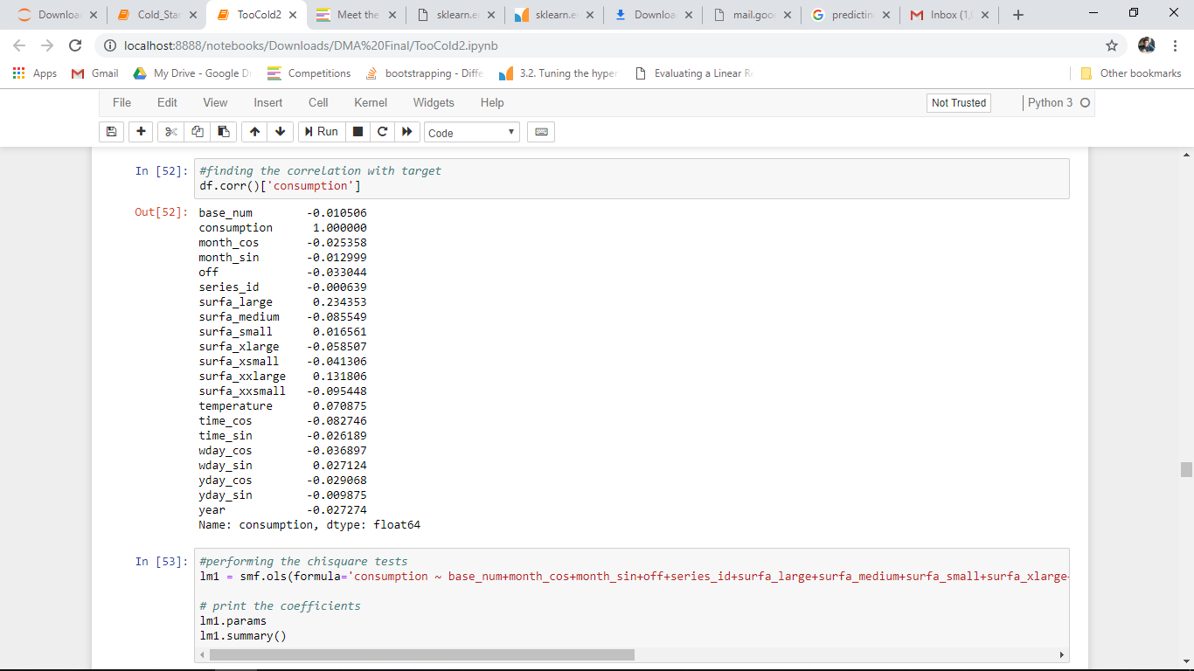
DATA PREPROCESSING
Feature Engineering
Dropping columns yday_sin, month_cos

Slide 15
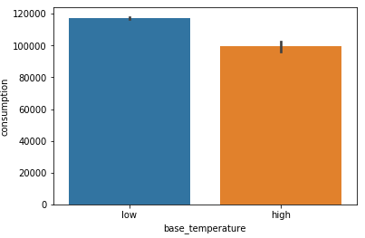
PREPARING TRAINING DATA
Looking back at data understanding
The high/low temperature in the base temperature does’nt imply any relation with target

Slide 16
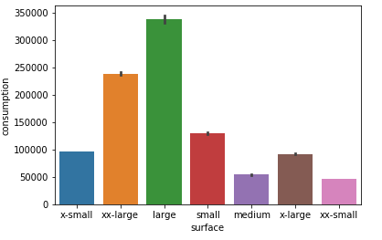
PREPARING TRAINING DATA
Looking back at data understanding
The surface (buildings) marked - 'large' consume the most energy

Slide 17
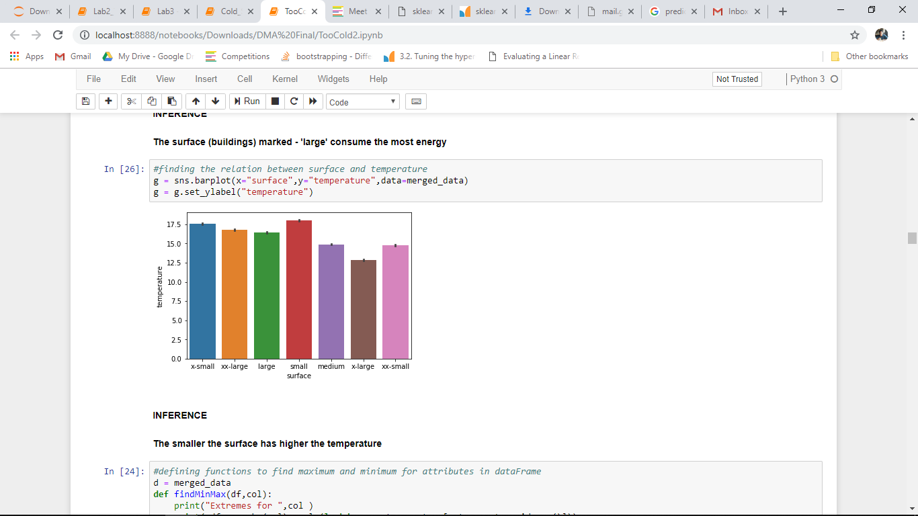
PREPARING TRAINING DATA
Looking back at data understanding
Surface doesn’t relate with temperature

Slide 18

MODELS
Linear Regression
Linear Regression establishes a relationship between dependent variable (Y) and one or more independent variables (X) using a best fit straight line

Slide 19
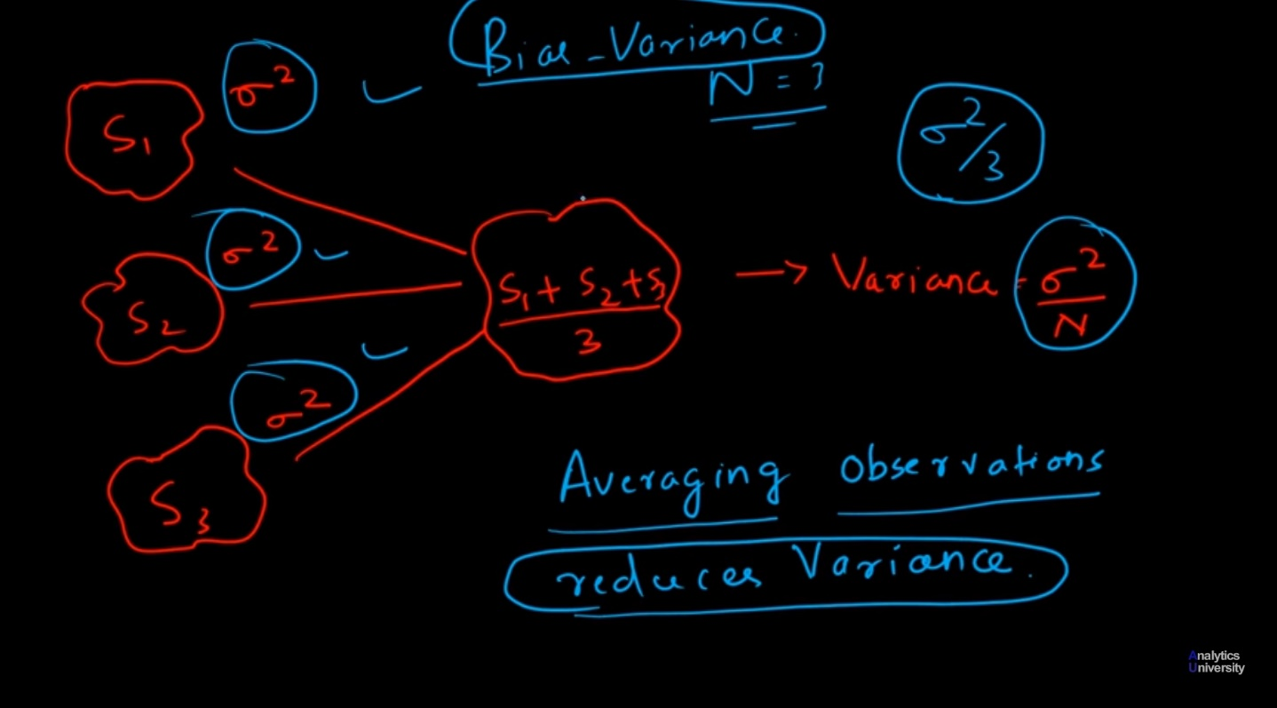
MODELS
Bagging
The variance is reduced in case of bagging.

Slide 20
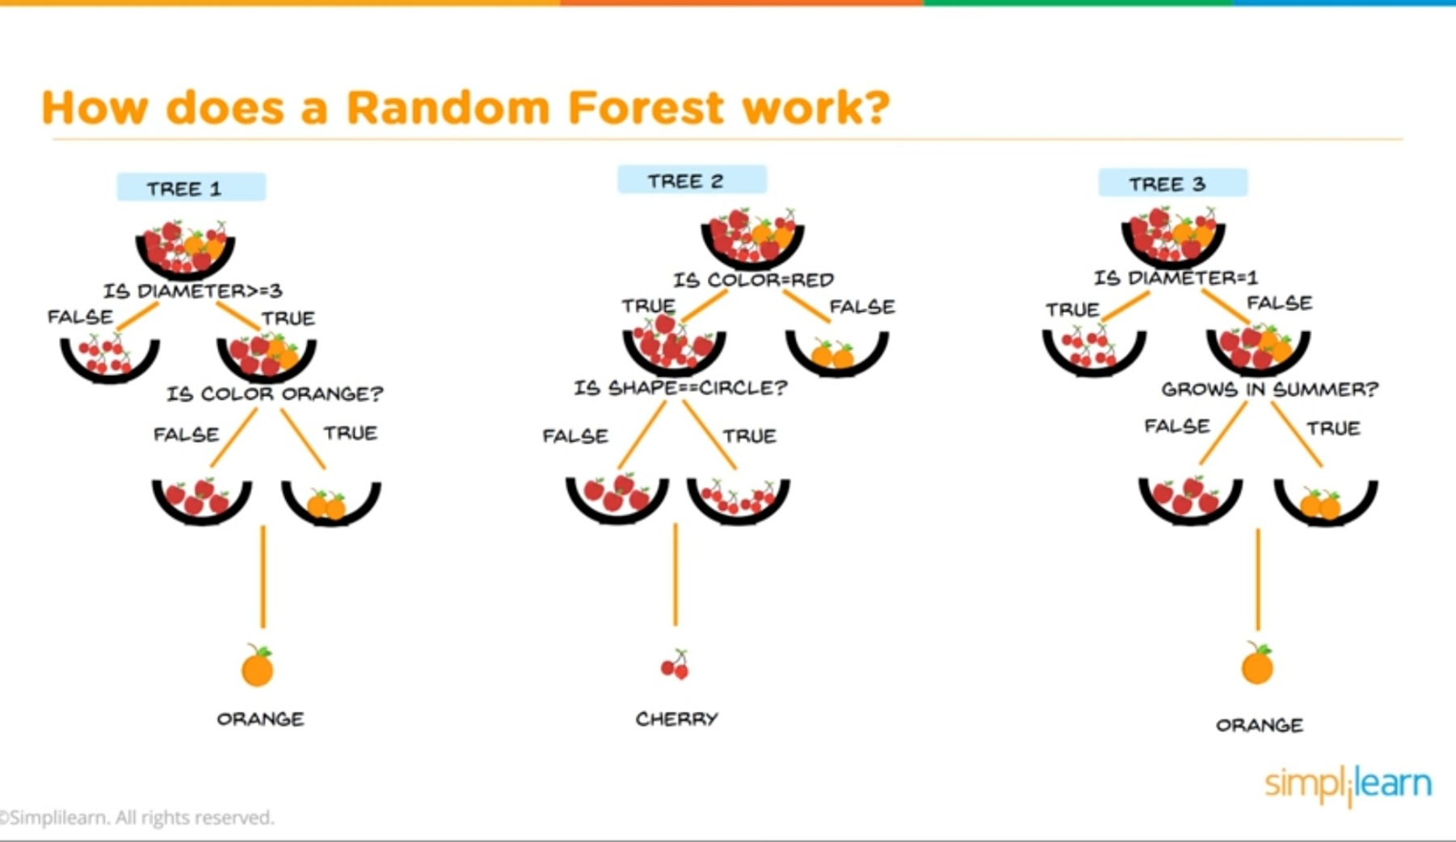
MODELS
Random forest Regressor
A random forest is a meta estimator that fits a number of classifying decision trees

Slide 21
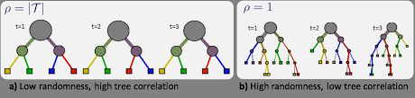
MODELS
Extra Trees Regressor
Instead of the most discriminative thresholds, thresholds are drawn at random for each candidate feature

Slide 22
Models and Score
MODEL | Score(R2_SCORE)
LinearRegression | 0.0976395086467
RandomForestRegressor | 0.982153104726
ExtraTreesRegressor | 0.9893852444566
BaggingRegressor | 0.98271301025
LSTM | 0.9645904985480551

Slide 23
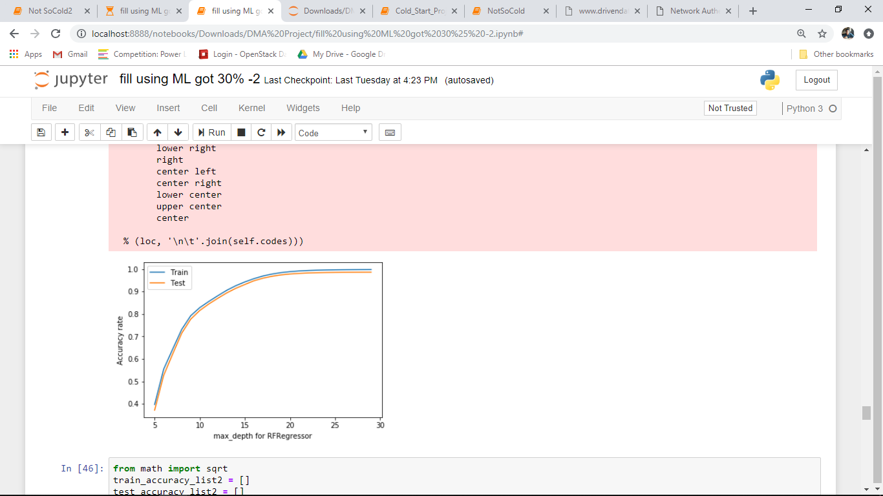
MODEL BUILDING
Parameter Tuning
Max_depth ==> Score
Max score at depth = 30
Inference = Iow bias – low variance

Slide 24
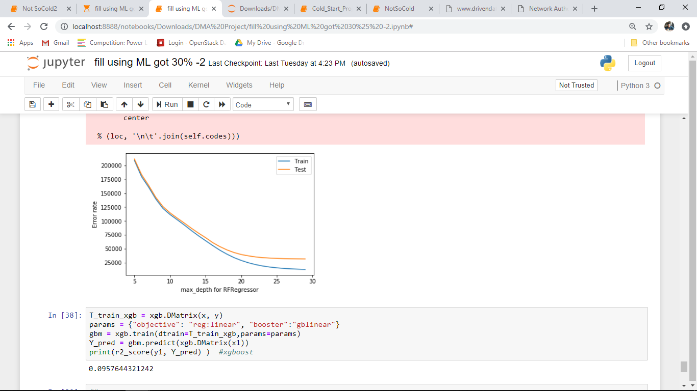
MODEL BUILDING
Parameter Tuning
Max_depth==> 1/ Error_rate
Min. error at depth = 30
Inference = Iow bias – low variance

Slide 25
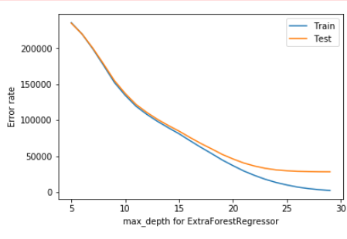
MODEL BUILDING
Parameter Tuning
Max_depth ==> 1/ Error_rate
Min. error at depth = 30
Inference = Iow bias – low variance

Slide 26
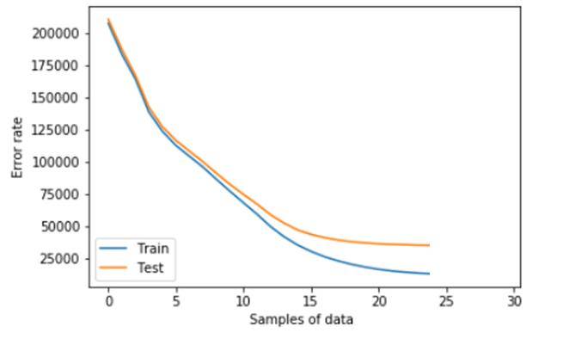
POST PROCESSING
Learning curve
Samples ==> 1/ Error_rate
Inference = Iow bias – low variance

Slide 27
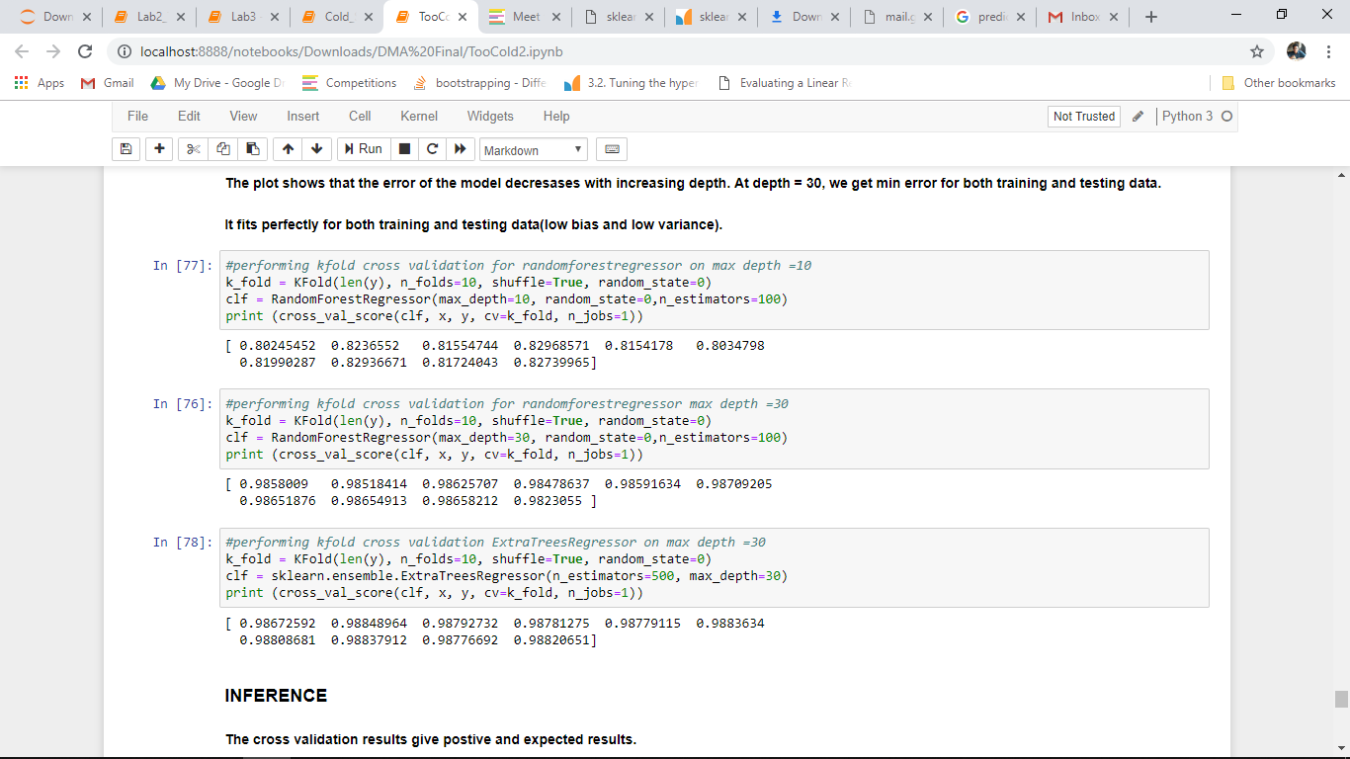
POST PROCESSING
K Fold Cross Validation
RFRegressor(max_depth = 10)
RFRegressor(max_depth = 30)
ETreesRegressor(max_depth = 30)

Slide 28
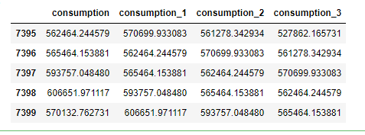
Time Series Forecasting (second approach)
Preprocessing : parsing date time
Creating lagged features
Normalization
Model Building
R2_SCORE0.9645904985480551

Slide 29
Submissions
Performance meteric :
NMAE = 1/N|Y`-Y|c
Our Bestscore = 11.23
Leader’ Bestscore = 0.26
Our Rank = 242
Total Paricipants = 1241

Slide 30
CONCLUSIONS
The meta data had important attributes that played important role.
The only attribute with missing values was the temperature; it was first filled via group by and later with machine learning.
The ensemble methods fit best than the linear models because of the non linear property of data.
The randomforestregressor and extratreesregressor gave score of 98.27 and 98.9 respectively and were better among all other ensemble techniques
The learning curves fit(neither underfit not overfit) well for both training and testing for both the models mentioned above.
LSTM does well but suffers from high bias.
The extratreesregressor would be used for prediction because of the accuracy and the fit over the validation curves.

Slide 31
REFERENCE
https://www.drivendata.org/competitions/55/schneider-cold-start

